Slide 1
MATLAB ASSINGMENT 1
By: Group 12

Slide 2
ASSIGNMENT PARTICIPANTS
NAME | REGISTRATION NUMBER | PROGRAM OF STUDY
OBBO DANIEL BENJAMIN | BU/UP/2024/1054 | WAR
TANGA RIGAN | BU/UP/2024/1071 | WAR
MIREMBE ROSE | BU/UP/2024/3835 | WAR
AGABA JOSHUA | BU/UP/2024/1009 | WAR
LWASAMPIJJA MIKE CRISPUS | BU/UG/2024/2678 | AMI
ISABIRYE EDMOND | BU/UP/2024/3733 | AMI
WANDABWA ELVIS | BU/UP/2024/1076 | WAR
APIO MIRIAM | BU/UP/2024/3827 | WAR
GINATH RUTH | BU/UP/2024/5468 | PTI

Slide 3
ABSTRACT
We started our first meeting for research on 18th September, 2025 in the university library and managed to achieve successful completion of this assignment through group work and division of tasks, and the achieved knowledge through the first assignment we did as a group as a tremendous means of consolidating the knowledge obtained to further the visualization of different parameters, patterns, trends and relationships of various variables represented as detailed plots as per the second assignment.

Slide 4
NUMBER ONE
Retrieve a unique data set from Kaggle.com in excel format.
Write a single MATLAB script to:
Read the data set into MATLAB
Copy the variables for each year in separate tables
Display data for each year on separate tables
Convert the tables into structural array

Slide 5
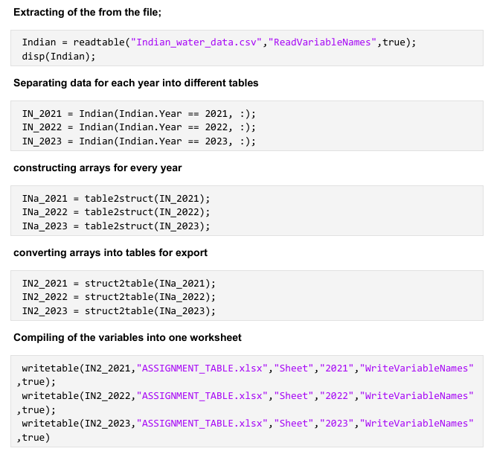
CODES USED FOR NUMBER ONE

Slide 6
NUMBER TWO
GROUP MEMBER DATA STORAGE
This exercise focused on a different aspect of data management: structuring varied data types into a single variable. The task was to take a set of attributes for each group member including home district, religion, tribe, interests, age, name, and a description for facial representation and store them collectively.
To accomplish this, we chose to utilize a structural array. Each element of the array represents a single group member, and each field within that element (e.g.,. Name,. Age,. interests) holds the corresponding attribute. This approach allows for logical grouping of related data and simplifies future access and manipulation of the information.
Our main task here was to get the data into the MATLAB environment, for that we utilized the MATLAB input feature. Using a script, we prompted the user to enter values for the attributes of the different group members; again, we utilized a loop for this. First, we prompted the user to enter the group size, in terms of number of members; and iterated the attribute prompts for each of the members

Slide 7
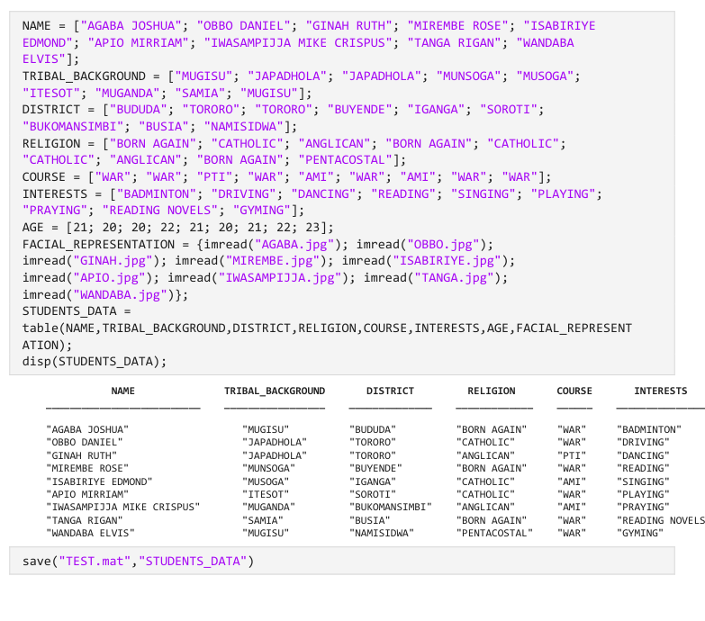
CODES USED FOR NUMBER TWO

Slide 8
CONCLUSION
At the end of this assignment a valuable learning experience was obtained and attained.
This boosted the key MATLAB learning experience of the participants

